Slide 1
Computer Security:
Principles and Practice
Fourth Edition
By: William Stallings and Lawrie Brown
Notes:
Lecture slides prepared for “Computer Security: Principles and Practice”, 4/e, by William Stallings and Lawrie Brown, Chapter 9 “Firewalls and Intrusion Prevention Systems”.

Slide 2
Chapter 9
Firewalls and Intrusion Prevention Systems
Notes:
Firewalls can be an effective means of protecting a local system or network of
systems from network-based security threats while at the same time affording access
to the outside world via wide area networks and the Internet.
Information systems in corporations, government agencies, and other organizations
have undergone a steady evolution. The following are notable developments:
• Centralized data processing system, with a central mainframe supporting a
number of directly connected terminals
• Local area networks (LANs) interconnecting PCs and terminals to each other
and the mainframe
• Premises network, consisting of a number of LANs, interconnecting PCs,
servers, and perhaps a mainframe or two
• Enterprise-wide network, consisting of multiple, geographically distributed
premises networks interconnected by a private wide area network (WAN)
• Internet connectivity, in which the various premises networks all hook into the
Internet and may or may not also be connected by a private WAN
• Enterprise cloud computing, which we will describe further in Chapter 13, with
virtualized servers located in one or more data centers that can provide both
internal organizational and external Internet accessible services.

Slide 3
Notes:
A firewall can monitor network traffic at a number of levels, from low-level network
packets, either individually or as part of a flow, to all traffic within a transport connection,
up to inspecting details of application protocols. The choice of which level
is appropriate is determined by the desired firewall access policy. It can operate as a
positive filter, allowing to pass only packets that meet specific criteria, or as a negative
filter, rejecting any packet that meets certain criteria. The criteria implement the
access policy for the firewall that we discussed in the previous section. Depending
on the type of firewall, it may examine one or more protocol headers in each packet,
the payload of each packet, or the pattern generated by a sequence of packets. In this
section, we look at the principal types of firewalls.

Slide 4
Packet Filtering Firewall
Applies rules to each incoming and outgoing IP packet
Typically a list of rules based on matches in the IP or TCP header
Forwards or discards the packet based on rules match
Two default policies:
Discard - prohibit unless expressly permitted
More conservative, controlled, visible to users
Forward - permit unless expressly prohibited
Easier to manage and use but less secure
Filtering rules are based on information contained in a network packet
Source IP address
Destination IP address
Source and destination transport-level address
IP protocol field
Interface
Notes:
A packet filtering firewall applies a set of rules to each incoming and outgoing
IP packet and then forwards or discards the packet ( Figure 9.1b ). The firewall
is typically configured to filter packets going in both directions (from and to
the internal network). Filtering rules are based on information contained in a
network packet:
• Source IP address: The IP address of the system that originated the IP packet
(e.g., 192.178.1.1)
• Destination IP address: The IP address of the system the IP packet is trying to
reach (e.g., 192.168.1.2)
• Source and destination transport-level address: The transport-level (e.g., TCP
or UDP) port number, which defines applications such as SNMP or HTTP.
• IP protocol field: Defines the transport protocol
• Interface: For a firewall with three or more ports, which interface of the firewall
the packet came from or for which interface of the firewall the packet is destined.
The packet filter is typically set up as a list of rules based on matches to fields
in the IP or TCP header. If there is a match to one of the rules, that rule is invoked
to determine whether to forward or discard the packet. If there is no match to any
rule, then a default action is taken. Two default policies are possible:
• Default = discard: That which is not expressly permitted is prohibited.
• Default = forward: That which is not expressly prohibited is permitted.
The default discard policy is more conservative. Initially, everything is blocked,
and services must be added on a case-by-case basis. This policy is more visible to
users, who are more likely to see the firewall as a hindrance. However, this is the
policy likely to be preferred by businesses and government organizations. Further,
visibility to users diminishes as rules are created. The default forward policy increases
ease of use for end users but provides reduced security; the security administrator
must, in essence, react to each new security threat as it becomes known. This policy
may be used by generally more open organizations, such as universities.

Slide 5
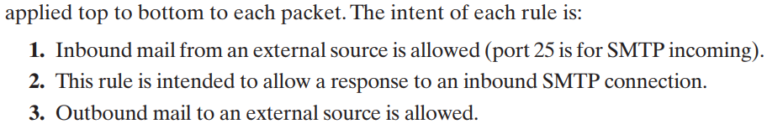
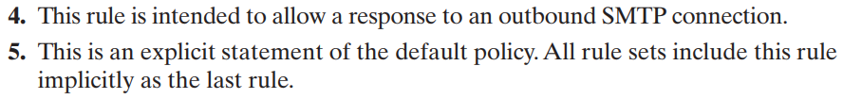
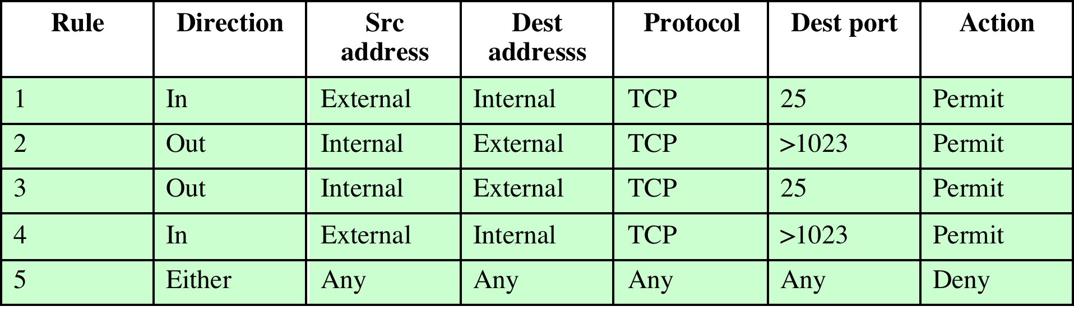
Table 9.1 Packet-Filtering Examples

Slide 6
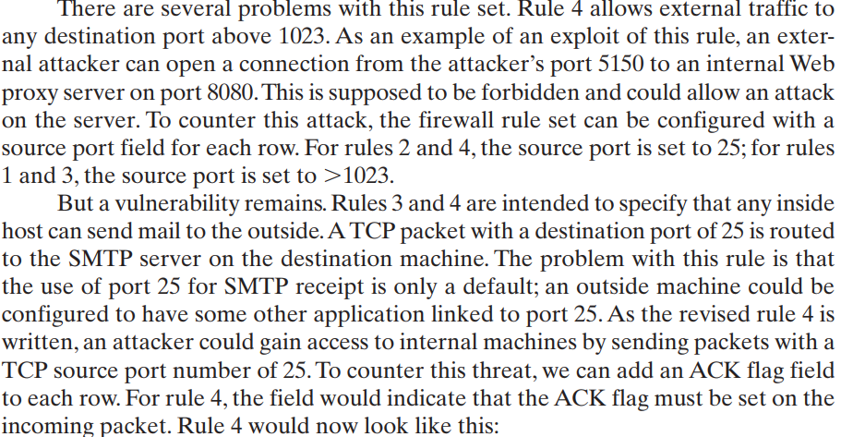
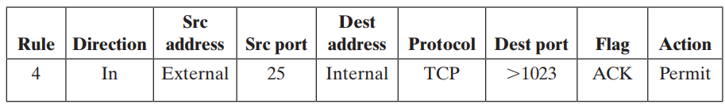

Slide 7
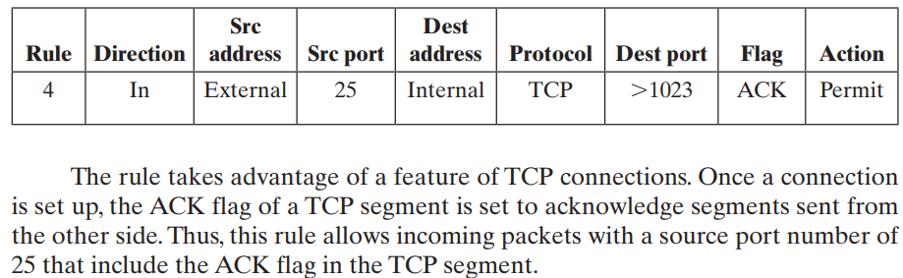
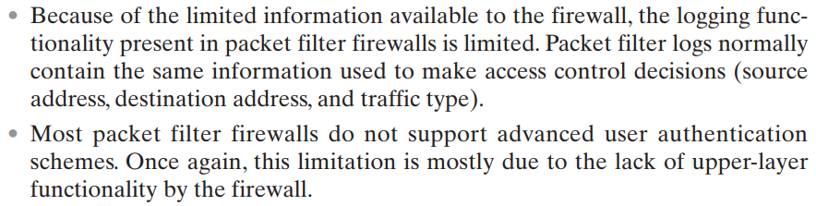

Slide 8
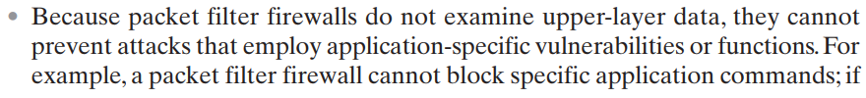
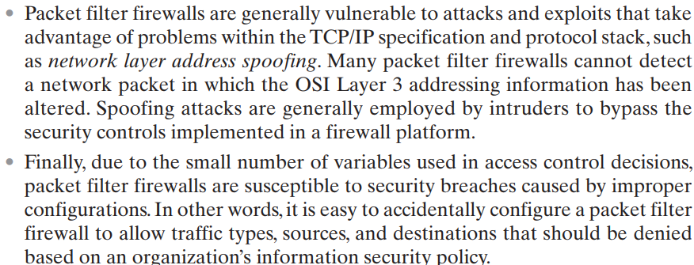

Slide 9
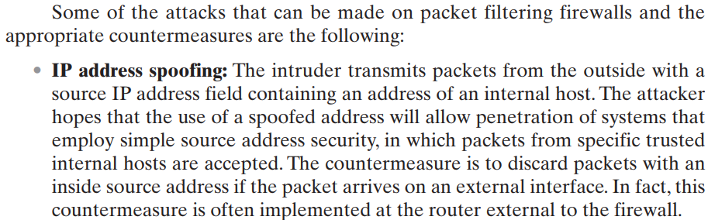
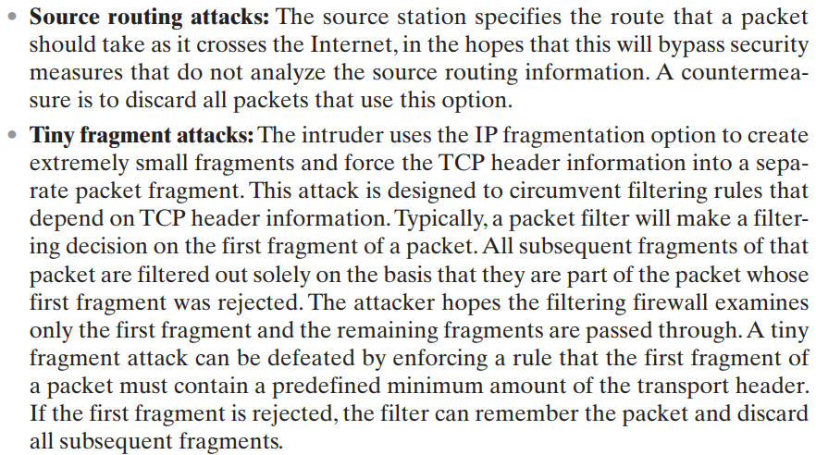

Slide 10
Packet Filter Advantages And Weaknesses
Advantages
Simplicity
Typically transparent to users and are very fast
Weaknesses
Cannot prevent attacks that employ application specific vulnerabilities or functions
Limited logging functionality
Do not support advanced user authentication
Vulnerable to attacks on TCP/IP protocol bugs
Improper configuration can lead to breaches
Notes:
One advantage of a packet filtering firewall is its simplicity. Also, packet filters
typically are transparent to users and are very fast. NIST SP 800-41 lists the following
weaknesses of packet filter firewalls:
• Because packet filter firewalls do not examine upper-layer data, they cannot
prevent attacks that employ application-specific vulnerabilities or functions.
For example, a packet filter firewall cannot block specific application
commands; if a packet filter firewall allows a given application, all functions
available within that application will be permitted.
• Because of the limited information available to the firewall, the logging
functionality present in packet filter firewalls is limited. Packet filter logs
normally contain the same information used to make access control decisions
(source address, destination address, and traffic type).
• Most packet filter firewalls do not support advanced user authentication
schemes. Once again, this limitation is mostly due to the lack of upper-layer
functionality by the firewall.
• Packet filter firewalls are generally vulnerable to attacks and exploits that take
advantage of problems within the TCP/IP specification and protocol stack,
such as network layer address spoofing . Many packet filter firewalls cannot
detect a network packet in which the OSI Layer 3 addressing information has
been altered. Spoofing attacks are generally employed by intruders to bypass
the security controls implemented in a firewall platform.
• Finally, due to the small number of variables used in access control decisions,
packet filter firewalls are susceptible to security breaches caused by improper
configurations. In other words, it is easy to accidentally configure a packet
filter firewall to allow traffic types, sources, and destinations that should be
denied based on an organization’s information security policy.
Some of the attacks that can be made on packet filtering firewalls and the
appropriate countermeasures are the following:
• IP address spoofing : The intruder transmits packets from the outside with a
source IP address field containing an address of an internal host. The attacker
hopes that the use of a spoofed address will allow penetration of systems that
employ simple source address security, in which packets from specific trusted
internal hosts are accepted. The countermeasure is to discard packets with an
inside source address if the packet arrives on an external interface. In fact, this
countermeasure is often implemented at the router external to the firewall.
• Source routing attacks: The source station specifies the route that a packet
should take as it crosses the Internet, in the hopes that this will bypass security
measures that do not analyze the source routing information. A countermeasure
is to discard all packets that use this option.
• Tiny fragment attacks: The intruder uses the IP fragmentation option to create
extremely small fragments and force the TCP header information into
a separate packet fragment. This attack is designed to circumvent filtering
rules that depend on TCP header information. Typically, a packet filter
will make a filtering decision on the first fragment of a packet. All subsequent
fragments of that packet are filtered out solely on the basis that
they are part of the packet whose first fragment was rejected. The attacker
hopes that the filtering firewall examines only the first fragment and that
the remaining fragments are passed through. A tiny fragment attack can be
defeated by enforcing a rule that the first fragment of a packet must contain
a predefined minimum amount of the transport header. If the first fragment
is rejected, the filter can remember the packet and discard all subsequent
fragments.

Slide 11
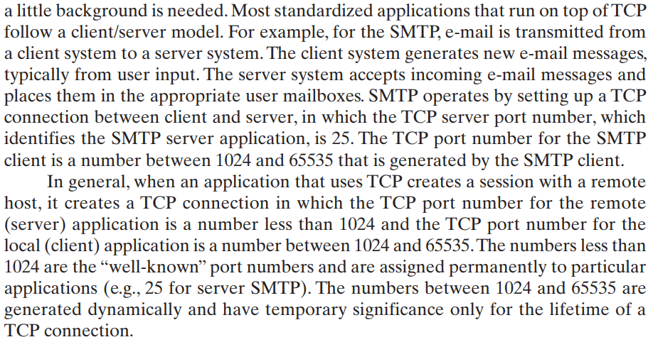

Slide 12
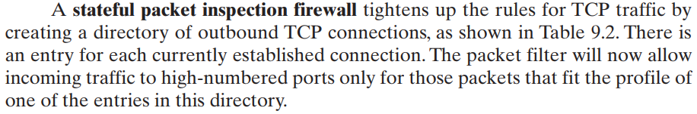
Why we need Stateful Inspection Firewall?

Slide 13
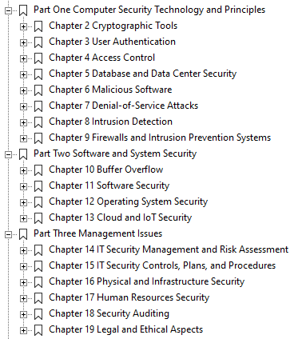

Slide 14
Stateful Inspection Firewall
Tightens rules for TCP traffic by creating a directory of outbound TCP connections
There is an entry for each currently established connection
Packet filter allows incoming traffic to high numbered ports only for those packets that fit the profile of one of the entries in this directory
Reviews packet information but also records information about TCP connections
Keeps track of TCP sequence numbers to prevent attacks that depend on the sequence number
Inspects data for protocols like FTP, IM and SIPS commands
Notes:
A traditional packet filter makes filtering decisions on an individual packet basis
and does not take into consideration any higher-layer context. To understand what
is meant by context and why a traditional packet filter is limited with regard to context,
a little background is needed. Most standardized applications that run on top
of TCP follow a client/server model. For example, for the Simple Mail Transfer
Protocol (SMTP), e-mail is transmitted from a client system to a server system.
The client system generates new e-mail messages, typically from user input. The
server system accepts incoming e-mail messages and places them in the appropriate
user mailboxes. SMTP operates by setting up a TCP connection between client
and server, in which the TCP server port number, which identifies the SMTP server
application, is 25. The TCP port number for the SMTP client is a number between
1024 and 65535 that is generated by the SMTP client.
In general, when an application that uses TCP creates a session with a remote
host, it creates a TCP connection in which the TCP port number for the remote
(server) application is a number less than 1024 and the TCP port number for the
local (client) application is a number between 1024 and 65535. The numbers less
than 1024 are the “well-known” port numbers and are assigned permanently to
particular applications (e.g., 25 for server SMTP). The numbers between 1024 and
65535 are generated dynamically and have temporary significance only for the
lifetime of a TCP connection.
A simple packet filtering firewall must permit inbound network traffic on all
these high-numbered ports for TCP-based traffic to occur. This creates a vulnerability
that can be exploited by unauthorized users.

Slide 15
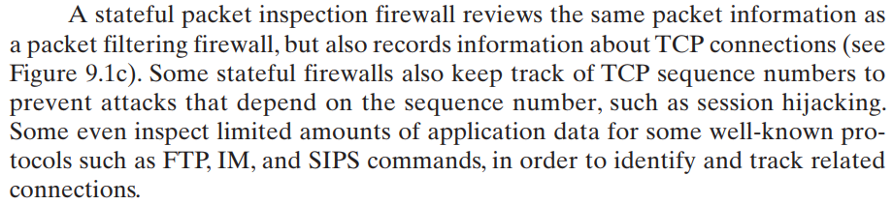
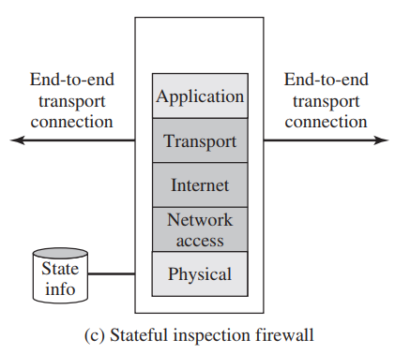
Stateful Inspection Firewall

Slide 16
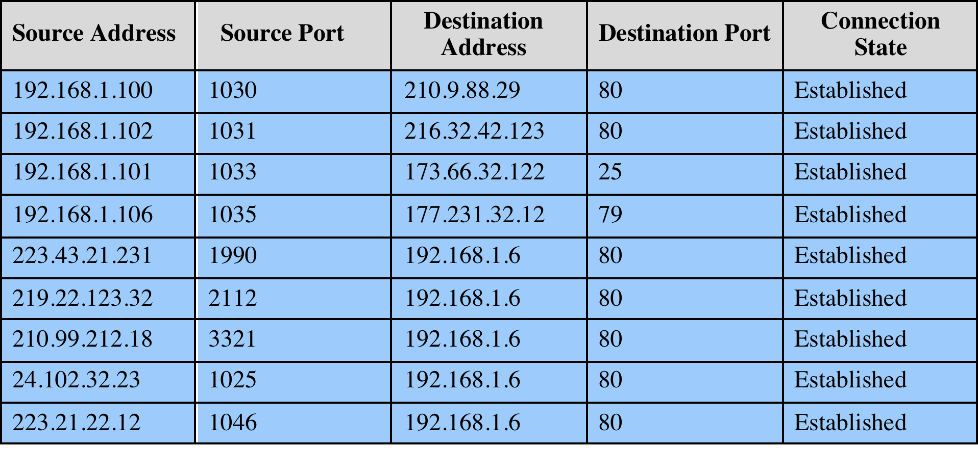
Table 9.2
Example Stateful Firewall
Connection State Table
Notes:
A stateful inspection packet firewall tightens up the rules for TCP traffic by
creating a directory of outbound TCP connections, as shown in Table 9.2 . There is
an entry for each currently established connection. The packet filter will now allow
incoming traffic to high-numbered ports only for those packets that fit the profile of
one of the entries in this directory.
A stateful packet inspection firewall reviews the same packet information
as a packet filtering firewall, but also records information about TCP connections
(Figure 9.1c). Some stateful firewalls also keep track of TCP sequence numbers
to prevent attacks that depend on the sequence number, such as session hijacking.
Some even inspect limited amounts of application data for some well-known
protocols like FTP, IM, and SIPS commands, in order to identify and track related
connections.

Slide 17
Application-Level Gateway
Also called an application proxy
Acts as a relay of application-level traffic
User contacts gateway using a TCP/IP application
User is authenticated
Gateway contacts application on remote host and relays TCP segments between server and user
Must have proxy code for each application
May restrict application features supported
Tend to be more secure than packet filters
Disadvantage is the additional processing overhead on each connection
Notes:
An application-level gateway, also called an application proxy , acts as a relay of
application-level traffic ( Figure 9.1d ). The user contacts the gateway using a TCP/
IP application, such as Telnet or FTP, and the gateway asks the user for the name
of the remote host to be accessed. When the user responds and provides a valid
user ID and authentication information, the gateway contacts the application on
the remote host and relays TCP segments containing the application data between
the two endpoints. If the gateway does not implement the proxy code for a specific
application, the service is not supported and cannot be forwarded across the firewall.
Further, the gateway can be configured to support only specific features of an
application that the network administrator considers acceptable while denying all
other features.
Application-level gateways tend to be more secure than packet filters. Rather
than trying to deal with the numerous possible combinations that are to be allowed
and forbidden at the TCP and IP level, the application-level gateway need only
scrutinize a few allowable applications. In addition, it is easy to log and audit all
incoming traffic at the application level.
A prime disadvantage of this type of gateway is the additional processing
overhead on each connection. In effect, there are two spliced connections between
the end users, with the gateway at the splice point, and the gateway must examine
and forward all traffic in both directions.

Slide 18
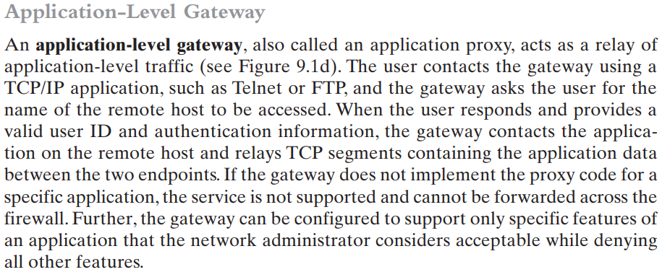
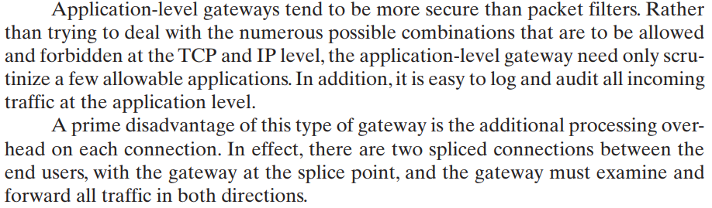

Slide 19
Circuit-Level Gateway
Circuit level proxy
Sets up two TCP connections, one between itself and a TCP user on an inner host and one on an outside host
Relays TCP segments from one connection to the other without examining contents
Security function consists of determining which connections will be allowed
Typically used when inside users are trusted
May use application-level gateway inbound and circuit-level gateway outbound
Lower overheads
Notes:
A fourth type of firewall is the circuit-level gateway or circuit-level proxy ( Figure 9.1e ).
This can be a stand-alone system or it can be a specialized function performed by an
application-level gateway for certain applications. As with an application gateway,
a circuit-level gateway does not permit an end-to-end TCP connection; rather,
the gateway sets up two TCP connections, one between itself and a TCP user on
an inner host and one between itself and a TCP user on an outside host. Once the
two connections are established, the gateway typically relays TCP segments from
one connection to the other without examining the contents. The security function
consists of determining which connections will be allowed.
A typical use of circuit-level gateways is a situation in which the system
administrator trusts the internal users. The gateway can be configured to support
application-level or proxy service on inbound connections and circuit-level functions
for outbound connections. In this configuration, the gateway can incur the processing
overhead of examining incoming application data for forbidden functions but
does not incur that overhead on outgoing data.

Slide 20
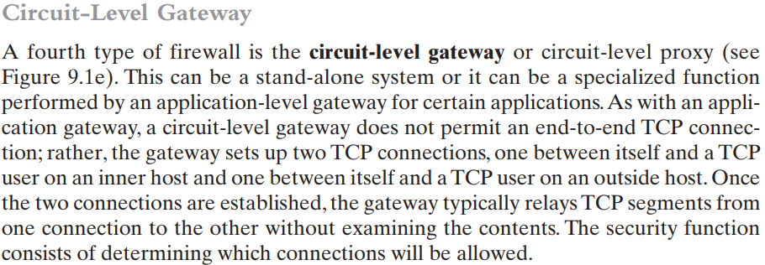
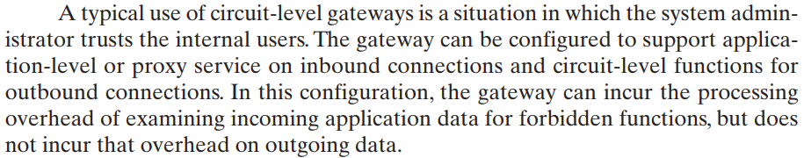

Slide 21
Intrusion Prevention Systems (IPS)
Also known as Intrusion Detection and Prevention System (IDPS)
Is an extension of an IDS that includes the capability to attempt to block or prevent detected malicious activity
Can be host-based, network-based, or distributed/hybrid
Can use anomaly detection to identify behavior that is not that of legitimate users, or signature/heuristic detection to identify known malicious behavior can block traffic as a firewall does, but makes use of the types of algorithms developed for IDSs to determine when to do so
Notes:
A further addition to the range of security products is the intrusion prevention system
(IPS), also known as intrusion detection and prevention system (IDPS). It is
an extension of an IDS that includes the capability to attempt to block or prevent
detected malicious activity. Like an IDS, an IPS can be host-based, network-based,
or distributed/hybrid, as we discuss in Chapter 8. Similarly, it can use anomaly
detection to identify behavior that is not that of legitimate users, or signature/heuristic
detection to identify known malicious behavior.
Once an IDS has detected malicious activity, it can respond by modifying
or blocking network packets across a perimeter or into a host, or by modifying or
blocking system calls by programs running on a host. Thus, a network IPS can block
traffic, as a firewall does, but makes use of the types of algorithms developed for
IDSs to determine when to do so. It is a matter of terminology whether a network
IPS is considered a separate, new type of product or simply another form of firewall.

Slide 22
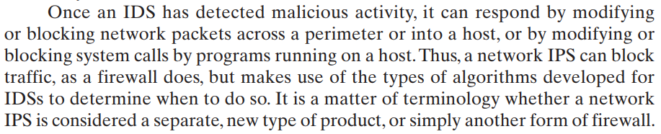

Slide 23
Host-Based IPS (HIPS)
Can make use of either signature/heuristic or anomaly detection techniques to identify attacks
Signature: focus is on the specific content of application network traffic, or of sequences of system calls, looking for patterns that have been identified as malicious
Anomaly: IPS is looking for behavior patterns that indicate malware
Examples of the types of malicious behavior addressed by a HIPS include:
Modification of system resources
Privilege-escalation exploits
Buffer-overflow exploits
Access to e-mail contact list
Directory traversal
Notes:
A host-based IPS (HIPS) can make use of either signature/heuristic or anomaly
detection techniques to identify attacks. In the former case, the focus is on the specific
content of application network traffic, or of sequences of system calls, looking
for patterns that have been identified as malicious. In the case of anomaly detection,
the IPS is looking for behavior patterns that indicate malware. Examples of the
types of malicious behavior addressed by a HIPS include the following:
• Modification of system resources: Rootkits, Trojan horses, and backdoors
operate by changing system resources, such as libraries, directories, registry
settings, and user accounts.
• Privilege-escalation exploits: These attacks attempt to give ordinary users
root access.
• Buffer-overflow exploits: These attacks are described in Chapter 10 .
• Access to e-mail contact list: Many worms spread by mailing a copy of themselves
to addresses in the local system’s e-mail address book.
• Directory traversal: A directory traversal vulnerability in a Web server allows
the hacker to access files outside the range of what a server application user
would normally need to access.

Slide 24
HIPS
Capability can be tailored to the specific platform
A set of general purpose tools may be used for a desktop or server system
Some packages are designed to protect specific types of servers, such as Web servers and database servers
In this case the HIPS looks for particular application attacks
Can use a sandbox approach
Sandboxes are especially suited to mobile code such as Java applets and scripting languages
HIPS quarantines such code in an isolated system area then runs the code and monitors its behavior
Areas for which a HIPS typically offers desktop protection:
System calls
File system access
System registry settings
Host input/output
Notes:
Attacks such as these result in behaviors that can be analyzed by a HIPS. The
HIPS capability can be tailored to the specific platform. A set of general-purpose
tools may be used for a desktop or server system. Some HIPS packages are designed
to protect specific types of servers, such as Web servers and database servers. In this
case, the HIPS looks for particular application attacks.
In addition to signature and anomaly-detection techniques, a HIPS can use
a sandbox approach. Sandboxes are especially suited to mobile code, such as Java
applets and scripting languages. The HIPS quarantines such code in an isolated
system area, then runs the code and monitors its behavior. If the code violates
predefined policies or matches predefined behavior signatures, it is halted and
prevented from executing in the normal system environment.
[ROBB06a] lists the following as areas for which a HIPS typically offers desktop
protection:
• System calls: The kernel controls access to system resources such as memory,
I/O devices, and processor. To use these resources, user applications invoke
system calls to the kernel. Any exploit code will execute at least one system
call. The HIPS can be configured to examine each system call for malicious
characteristics.
• File system access: The HIPS can ensure that file access system calls are not
malicious and meet established policy.
System registry settings: The registry maintains persistent configuration
information about programs and is often maliciously modified to extend the
life of an exploit. The HIPS can ensure that the system registry maintains its
integrity.
• Host input/output: I/O communications, whether local or network based, can
propagate exploit code and malware. The HIPS can examine and enforce
proper client interaction with the network and its interaction with other
devices.

Slide 25
The Role of HIPS
Many industry observers see the enterprise endpoint, including desktop and laptop systems, as now the main target for hackers and criminals
Thus security vendors are focusing more on developing endpoint security products
Traditionally, endpoint security has been provided by a collection of distinct products, such as antivirus, antispyware, antispam, and personal firewalls
Approach is an effort to provide an integrated, single-product suite of functions
Advantages of the integrated HIPS approach are that the various tools work closely together, threat prevention is more comprehensive, and management is easier
A prudent approach is to use HIPS as one element in a defense-in-depth strategy that involves network-level devices, such as either firewalls or network-based IPSs
Notes:
Many industry observers see the enterprise endpoint,
including desktop and laptop systems, as now the main target for hackers and
criminals, more so than network devices [ROBB06b]. Thus, security vendors are
focusing more on developing endpoint security products. Traditionally, endpoint
security has been provided by a collection of distinct products, such as antivirus,
antispyware, antispam, and personal firewalls. The HIPS approach is an effort to
provide an integrated, single-product suite of functions. The advantages of the
integrated HIPS approach are that the various tools work closely together, threat
prevention is more comprehensive, and management is easier.
It may be tempting to think that endpoint security products such as HIPS,
if sophisticated enough, eliminate or at least reduce the need for network-level
devices. For example, the San Diego Supercomputer Center reports that over a
four-year period, there were no intrusions on any of its managed machines, in a
configuration with no firewalls and just endpoint security protection [SING03].
Nevertheless, a more prudent approach is to use HIPS as one element in a strategy
that involves network-level devices, such as either firewalls or network-based
IPSs.

Slide 26
Network-Based IPS (NIPS)
Inline NIDS with the authority to modify or discard packets and tear down TCP connections
Makes use of signature/heuristic detection and anomaly detection
May provide flow data protection
Requires that the application payload in a sequence of packets be reassembled
Methods used to identify malicious packets:
Pattern matching
Stateful matching
Protocol anomaly
Traffic anomaly
Statistical anomaly
Notes:
A network-based IPS (NIPS) is in essence an inline NIDS with the authority to
discard packets and tear down TCP connections. As with a NIDS, a NIPS makes use
of techniques such as signature detection and anomaly detection.
Among the techniques used in a NIPS but not commonly found in a firewall
is flow data protection. This requires that the application payload in a sequence
of packets be reassembled. The IPS device applies filters to the full content of the
flow every time a new packet for the flow arrives. When a flow is determined to be
malicious, the latest and all subsequent packets belonging to the suspect flow are
dropped.
In terms of the general methods used by a NIPS device to identify malicious
packets, the following are typical:
• Pattern matching: Scans incoming packets for specific byte sequences (the
signature) stored in a database of known attacks
• Stateful matching: Scans for attack signatures in the context of a traffic stream
rather than individual packets
• Protocol anomaly: Looks for deviation from standards set forth in RFCs
Traffic anomaly: Watches for unusual traffic activities, such as a flood of UDP
packets or a new service appearing on the network
• Statistical anomaly: Develops baselines of normal traffic activity and throughput,
and alerts on deviations from those baselines

Slide 27
Digital Immune System
Comprehensive defense against malicious behavior caused by malware
Developed by IBM and refined by Symantec
Motivation for this development includes the rising threat of Internet-based malware, the increasing speed of its propagation provided by the Internet, and the need to acquire a global view of the situation
Success depends on the ability of the malware analysis system to detect new and innovative malware strains
Notes:
The final category of IPS is in a distributed or hybrid approach. This gathers data
from a large number of host and network-based sensors, relays this intelligence to
a central analysis system able to correlate, and analyze the data, which can then
return updated signatures and behavior patterns to enable all of the coordinated
systems to respond and defend against malicious behavior. A number of such systems
have been proposed. One of the best known is the digital immune system.
The digital immune system is a comprehensive defense
against malicious behavior caused by malware, developed by IBM [KEPH97a,
KEPH97b, WHIT99], and subsequently refined by Symantec [SYMA01] and
incorporated into its Central Quarantine produce [SYMA05]. The
motivation for this development includes the rising threat of Internet-based
malware, the increasing speed of its propagation provided by the Internet, and the
need to acquire a global view of the situation.
In response to the threat posed by these Internet-based capabilities, IBM
developed the original prototype digital immune system. This system expands on
the use of program emulation discussed in Section 6.10 and provides a general-purpose
emulation and malware detection system. The objective of this system is to
provide rapid response time so that malware can be stamped out almost as soon as
they are introduced. When new malware enters an organization, the immune system
automatically captures it, analyzes it, adds detection and shielding for it, removes it,
and passes information about it to client systems, so the malware can be detected
before it is allowed to run elsewhere.
The success of the digital immune system depends on the ability of the malware
analysis system to detect new and innovative malware strains. By constantly
analyzing and monitoring malware found in the wild, it should be possible to continually
update the digital immune software to keep up with the threat.

Slide 28
Figure 9.5 Placement of Malware Monitors (adapted from [SIDI05])
Notes:
Figure 9.5 shows an example of a hybrid architecture designed originally to
detect worms [SIDI05]. The system works as follows (numbers in figure refer to
numbers in the following list):
1. Sensors deployed at various network and host locations detect potential malware
scanning, infection or execution. The sensor logic can also be incorporated
in IDS sensors.
2. The sensors send alerts and copies of detected malware to a central server,
which correlates and analyzes this information. The correlation server determines
the likelihood that malware is being observed and its key characteristics.
3. The server forwards its information to a protected environment, where the
potential malware may be sandboxed for analysis and testing.
4. The protected system tests the suspicious software against an appropriately
instrumented version of the targeted application to identify the vulnerability.
5. The protected system generates one or more software patches and tests these.
6. If the patch is not susceptible to the infection and does not compromise the
application’s functionality, the system sends the patch to the application host
to update the targeted application.

Slide 29
Summary
Intrusion prevention systems
Host-based IPS
Network-based IPS
Distributed or hybrid IPS
Snort inline
The need for firewalls
Firewall characteristics and access policy
Types of firewalls
Packet filtering firewall
Stateful inspection firewalls
Application-level gateway
Circuit-level gateway
Notes:
Chapter 9 summary.

